Slide 1
ECE 5780 - Project Tank
By: Brian Burton, Matthew Hunsaker, Kashish Singh

Slide 2
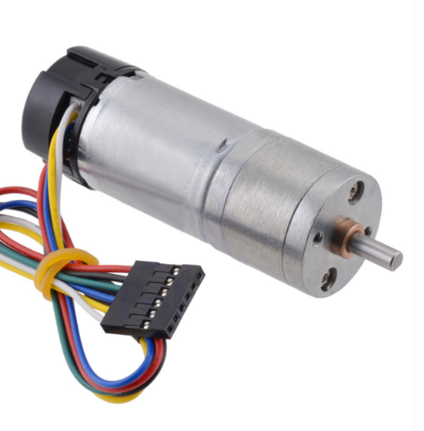
Completed Milestone 1:
We used HW assignments as a base
Created custom motor driver PCB boards
Bought needed supplies
Two POLOLU 6V motors
Battery powered power supply
Timing belts

Slide 3
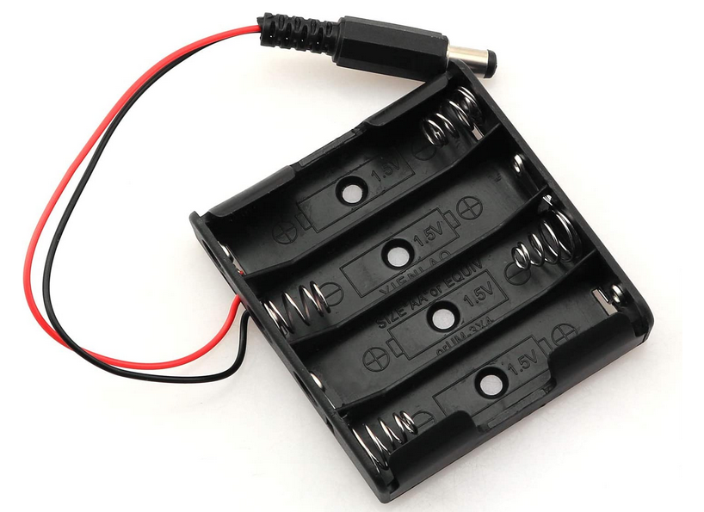
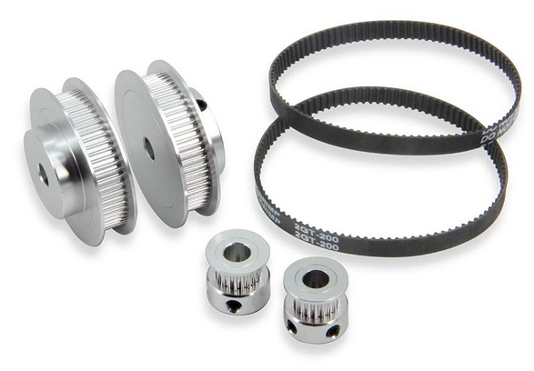
Completed Milestone 2:
Ensured that the motors and STM32 board could run off of battery power.
After programing STM32.
Mounted one motor and gear set to base.
Verified they run smoothly.

Slide 4
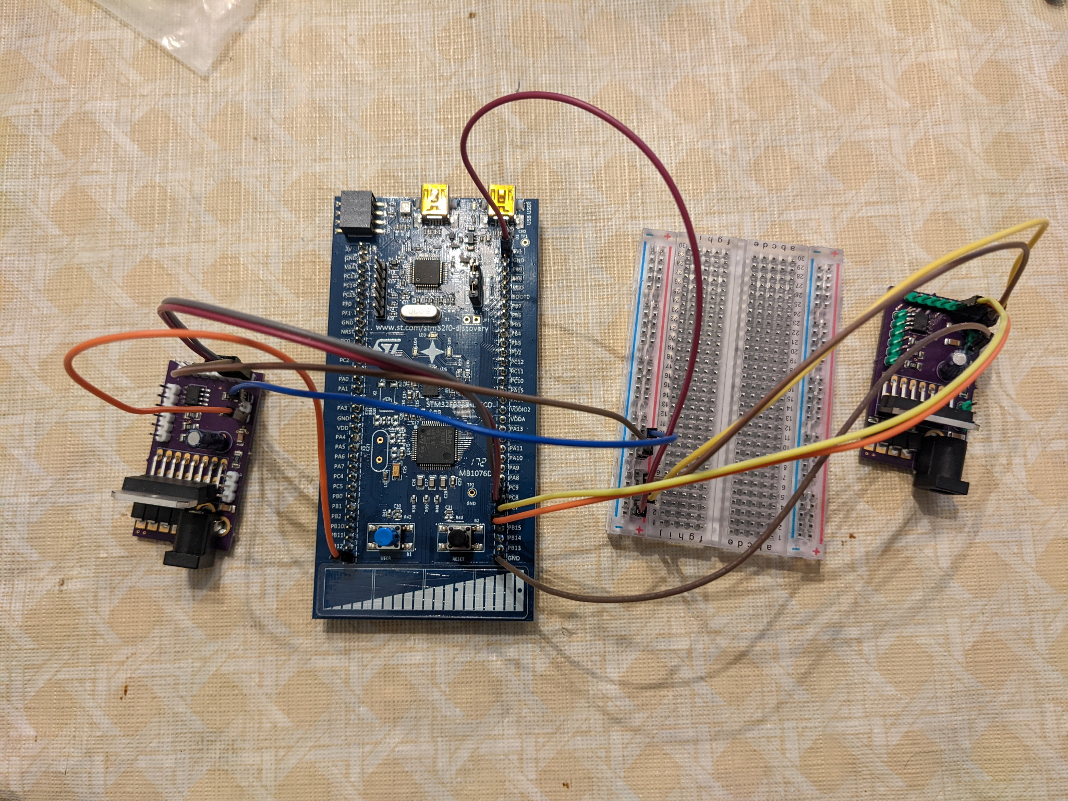
Completed Milestone 3:
Successfully 3D printed case for the top of the tank to keep the different components secured.
The two DC motors have been secured to the tank, one on the top left side and the other on the top right side

Slide 5
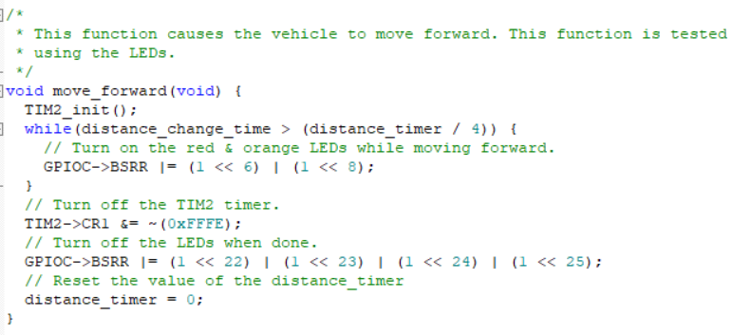
Software
Uses timers and interrupts to keep track of time travelled.
Uses the STM board user button and a debouncer.
Four directional functions that update the movement of the tank.
Uses the LEDs to indicate the current direction.

Slide 6
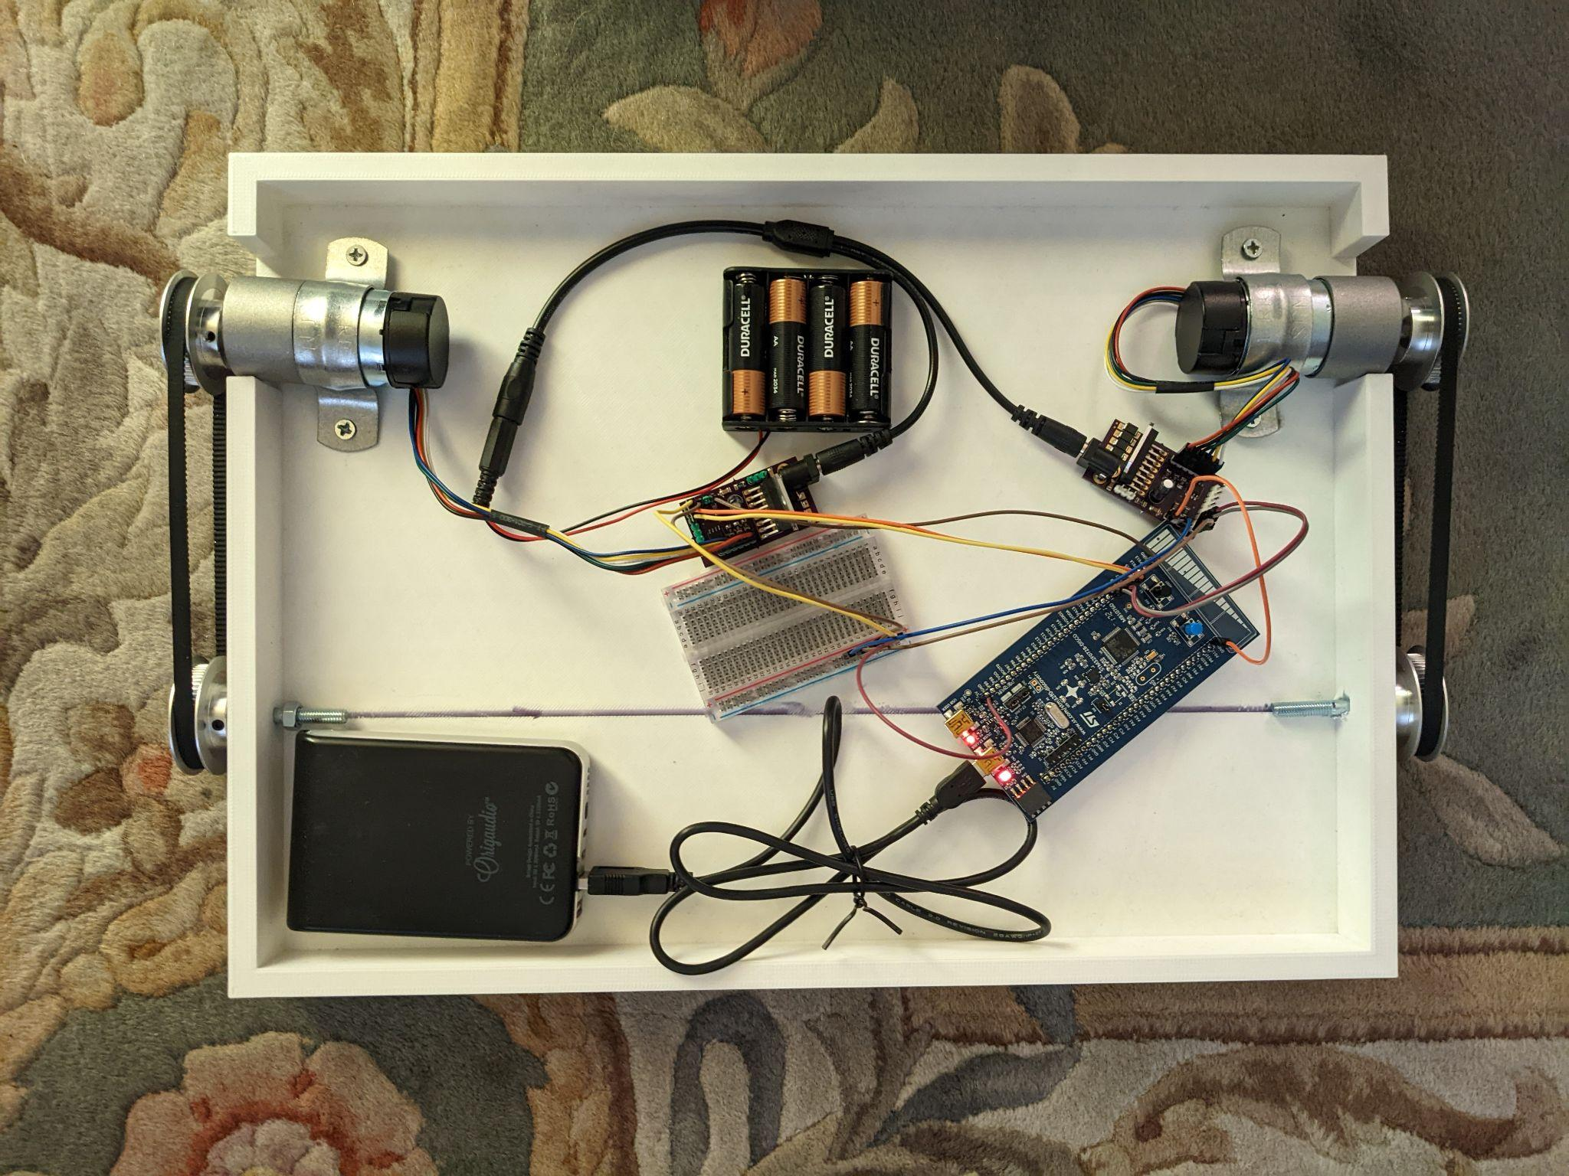
The finished product:
Features
Drive Forwards
Drive Backwards
Turn Left
Turn Right
Possible Features
Movable table

Slide 7

CTRL + Click Box to go to Drive link for the video

Slide 8
Thank You!

